Slide 1
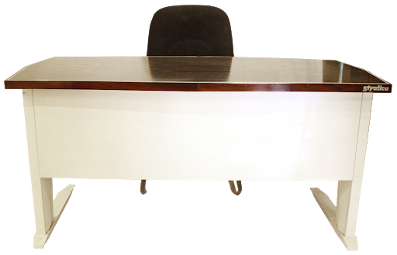
Announcements:
Volta Virtual Greet and Meet

